Slide 1

C# Database Fundamentals with Microsoft SQL Server
Course Introduction
SoftUni Team
Technical Trainers
Software University
https://softuni.bg/

Slide 2
Table of Contents
Course Objectives
Training and Team
Course Organization
Course Infrastructure
Evaluation Criteria

Slide 3
Have a Question?
sli.do
#CSharpDB

Slide 4

Course Objectives

Slide 5
C# Database Fundamentals Module Goals
Basic Database and Query Concepts
Content: SQL syntax, Data types, Programmability
ADO.NET Library
ORM Fundamentals
Entity Framework Core
Automapper Library and Custom Automapper
Best Practices and Architecture

Slide 6
Course Objectives
DB Intro, Data Definition and Data Types
Basic CRUD, Intro to SQL
Built-in functions with T-SQL
Data Aggregation
Table Relationships
Subqueries and Joins
Database Programmability

Slide 7
Practical Programming Exam
20 practical problems for 6 hours
DDL
DML
Querying
Programmability
Automated judge system
http://judge.softuni.bg
Solutions are evaluated for correctness only
Code quality is still not measured

Slide 8

Exam Demonstration

Slide 9

The Team

Slide 10


Stamo Petkov
Head Of Department at Information Services Plc.
Worked with various technologies
.NET and C#, BASIC, Pascal, Object Pascal, PHP
More than 15 years of experience
Experienced Lecturer
C# Basics and ASP.NET MVC @ Softuni

Slide 11
INFORMATION SERVICES
Key partner of the state institutions in the implementation of ICT projects
The Ministry of Finance
The National Revenue Agency
The Customs Agency
The Ministry of Regional Development and Public Works
The first governmentally approved provider of qualified certification services in Bulgaria
https://www.is-bg.net/bg/

Slide 12
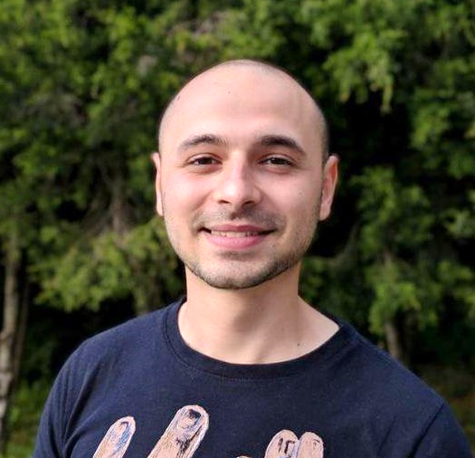
Stoyan Shopov
Technical Trainer @ SoftUni
ASP.NET Web Developer
Experience with MSSQL and ADO.NET
Mountain lover

Slide 13

Course Organization

Slide 14
C# Database Fundamentals Module – Timeline
15-Jan-2019
19-Feb-2019
19-Nov-2019
MSSQL
5 weeks * 4 times / week
9 credits
Start: 14-Jan-2019
Final exam: 17-Feb-2019
Entity Framework Core
7 weeks * 4 times / week
18 credits
Start: 18-Feb-2019
Final exam: 07-April-2019
Re-Take Exams
MSSQL Retake Exam: 09-Apr-2019
EF Core Retake Exam: 11-Apr-2019

Slide 15

Homework Assignments & Exercises
Your homework is mainly work in class
Lesson days → slides + live demos + exercises
Exercise days → only exercises
How to submit your homework?
Submitted in the judge system
Do your homework when it's due
Assignments pile up quickly

Slide 16


Scoring System for the Course
Mandatory:
Final exam – 85%
Exercises & homework – 15%
Bonuses:
Presence in class – 5% bonus
Forum activity – bonus up to 5%

Slide 17



Course Web Site, Forum and FB Group
Official web site:
Official discussion forum:
Official Facebook group:
https://softuni.bg/courses/databases-basics-ms-sql-server
https://softuni.bg/forum/categories/63/csharp-db-fundamentals
https://www.facebook.com/groups/ CSharpDBFUndamentalsJanuary2019/

Slide 18


The Free C# Fundamentals Textbook
The official textbook for the course
"Fundamentals of Computer Programming with C#", by Svetlin Nakov & Co., 2013, ISBN 9789544007737
English and Bulgarian versions (as PDF, ePub, …)
Freely downloadable from: www.introprogramming.info
The C# Programming courses @SoftUni.bg partially follows the book

Slide 19
https://softuni.bg/courses/csharp-advanced

Slide 20












SoftUni Diamond Partners

Slide 21




SoftUni Organizational Partners

Slide 22




Trainings @ Software University (SoftUni)
Software University – High-Quality Education and Employment Opportunities
softuni.bg
Software University Foundation
http://softuni.foundation/
Software University @ Facebook
facebook.com/SoftwareUniversity
Software University Forums
forum.softuni.bg

Slide 23

License
This course (slides, examples, demos, videos, homework, etc.) is licensed under the "Creative Commons Attribution-NonCommercial-ShareAlike 4.0 International" license

